Slide 1
Café billing system
Mini project by :
Shweta Kaware (A-05) (TU3F1920005)
Karishma Bairi (A-14) (Group Leader) (TU3F1920014)
Aman Lakhotra (A-20) (TU3F1920020)
Ketki Kulkarni (A-52) (TU3F1920053)
Under guidance of Dr. Siddharth Hariharan

Slide 2
Table of contents
Introduction
Aim & Objective
Problem Statement
Abstract
Literature Review
System Requirements
Frontend and backend
Methodology
Conclusion
Reference

Slide 3
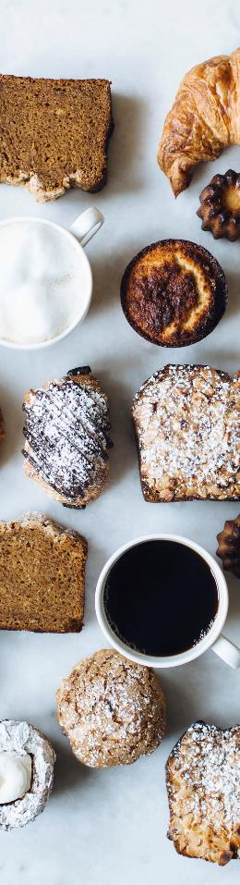
introduction
This system is named as Cafe Billing System.
This is designed especially for a Cafe which wants to attend their customers in a very well manner.
This system has the capability to take the orders from the customers.
This project sets to design, build and test a web-based computerized cafe billing system.
One of the driving forces behind the innovation of such a system is the attempt to replace the error prone and monotonous paper-based system.
Commonly, the workflow of the system would start from waiters gathering orders from the customer on an order sheet, then passing this to kitchen chefs for meal preparation and finally collecting payment from the customer.
IT has become important tools to support business operations.
Customer can opt for his/her choice of payment.
This system has the capability of calculating the bill according to the total number of the items ordered and taxes are also added accordingly, then shown to the customer in a proper bill.

Slide 4
Aim and objective
To create a self reliant cafe billing system with minimum error and fast result.
The main objective of the Cafe Billing System is to reduce manual work for managing the details of Customer details, Customer Payment Mode and Calculation of bill including taxes.
The project is totally built at administrative end and thus only the administrator is guaranteed the access.

Slide 5
Problem statement
The cafe owners and managers encounter various problem related to table management this is not the only case, they also face problem regarding staff management, order delivery and reception. This workload need at least a group of people to handle, but this program is combined solution for all these problems.

Slide 6
abstract
This simple Cafe Billing System project is written in Python.
The project file contains a python script (billing.py).
This is a simple GUI based application which is very easy to understand and use.
The user can view the total receipt of their items which displays receipt number and number of their food/drinks items with the total amount along with taxes.

Slide 7
Literature review
Year | Author Name | Paper Name | Description
2019 | Wong Siew Jiuan | http://eprints.utar.edu.my/3448/1/fyp_IA_2019_WSJ_1506513.pdf | The strength of this system is that the time has been reduced during billing. . Especially during the peak hours the customers do not need to wait for long time .The weakness of this system is it does not support real-time tax calculation. The customers are unable to see the percentage of tax included.
2017 | Shraddha G. Malviya | https://www.ijser.org/researchpaper/A-Review-Paper-on-Smart-Restaurant-Ordering-System.pdf | This system enhances the experience and save their time during billing . This project aims to save the time during billing process in cafe as well as to improve the dining experience of customers.

Slide 8
Year | Author Name | Paper Name | Description
2015 | Prof. N.M Yawale | http://www.iaetsdjaras.org/gallery/14-jaras-327-december.pdf | The system is implemented to reduce the manual work and enhances the accuracy of work in a cafe. This system manages and maintains the record of customers and their order . The billing system prepares the bill according to the food. This system entirely reduces the unnecessary time. The cost can be calculated in real time.
2013 | Ashwani Banker | https://www.irjet.net/archives/V7/i4/IRJET-V7I41009.pdf | This Cafe Billing system was developed in order to save their time during billing.The online survey showed that most people were satisfied with this biiling system.
2010 | Sakari Pieska | https://www.iosrjournals.org/iosr-jeee/Papers/Vol10-issue3/Version-1/A010310105.pdf | This billing system was used to enhance the accuracy of work. It was used to generate bills without any discrepancies by saving customers information.

Slide 9
System requirements
Processor | Core 2 Dual / 4.3 more
RAM | 1.2 GB or more
HDD | 500 GB / 1 TB or more
OS | Window 7 , 8 , 10
Database | Sqlite3
Software | Visual Studio Code

Slide 10
Frontend and backend
Frontend- The front-end is built using a combination of technologies such as Hypertext Markup Language (HTML), JavaScript and Cascading Style Sheets (CSS).Front-end developers design and construct the user experience elements on the web page or app including buttons, menus, pages, links, graphics and more.
The python language is one of the most accessible programming languages available because it has simplified syntax and not complicated, which gives more emphasis on natural language. Due to its ease of learning and usage, python codes can be easily written and executed much faster than other programming languages.
So in our project we have created Frontend using Python.

Slide 11
Backend- The back-end, also called the server side, consists of the server which provides data on request, the application which channels it, and the database which organizes the information. For example, when a customer browses shoes on a website, they are interacting with the front end.
Sqlite is a very popular database which has been successfully used with on disk file format for desktop applications like version control systems, financial analysis tools, media cataloging and editing suites, CAD packages, record keeping programs etc.
Reading and writing operations are very fast for Sqlite database. Sqlite is very easy to learn. Sqlite is portable across all 32-bit and 64-bit operating systems. Sqlite database is accessible through a wide variety of third-party tools. Sqlite is free for all users.
Hence we have created Backend using Sqlite3.

Slide 12
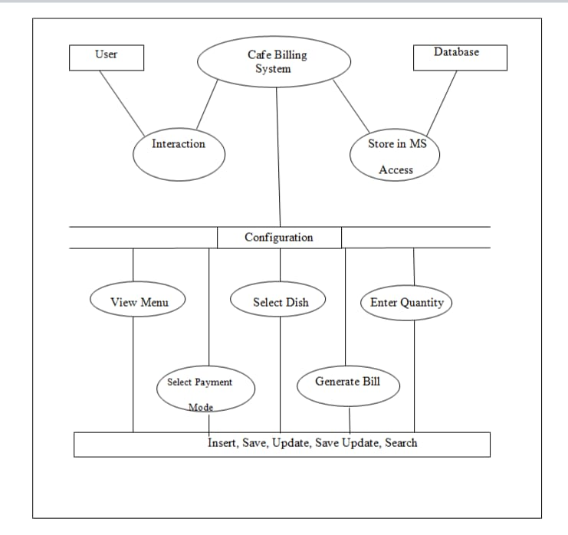
methodology
BLOCK DIAGRAM

Slide 13
Block diagram explanation
This block diagram describes the working of Cafe Billing System.
It is a connecting link between the user and database.
User interacts with the system and database stores information regarding the customer and its bill.
It has some options which can be accessed i.e Menu, Bill Counter, Calculator. In the menu option the list of dishes with its cost will be displayed.
In the bill counter option there are many tabs which are used to select the dishes, enter quantity of that dish, selection of payment mode and then generation of bill with taxes.
All this process consists of insertion, saving, updation, saving of updated information and searching.

Slide 14
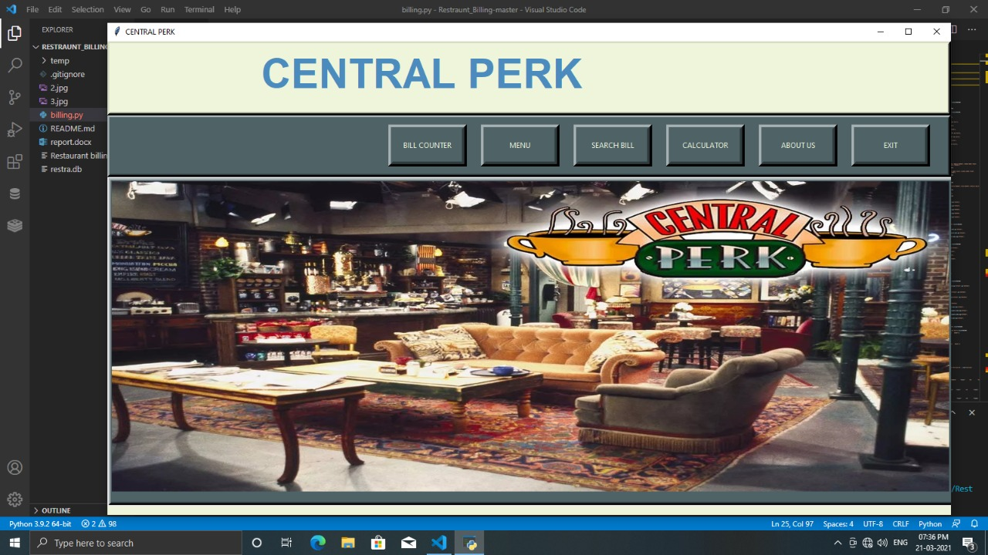
OUTPUT
This figure shows the home page of our Cafe Billing System. It consists of 6 buttons which are Bill Counter, Menu, Search Bill, Calculator, About Us and Exit.
Bill Counter : It displays the calculated bill of the customer along with taxes.
Menu : It displays the Menu Card for ordering.
Search Bill : It searches the bill of the particular customer.
Calculator : It is used for calculation purpose.
About Us : This gives a short information about the Cafe.
Exit : This is used to close the System.

Slide 15
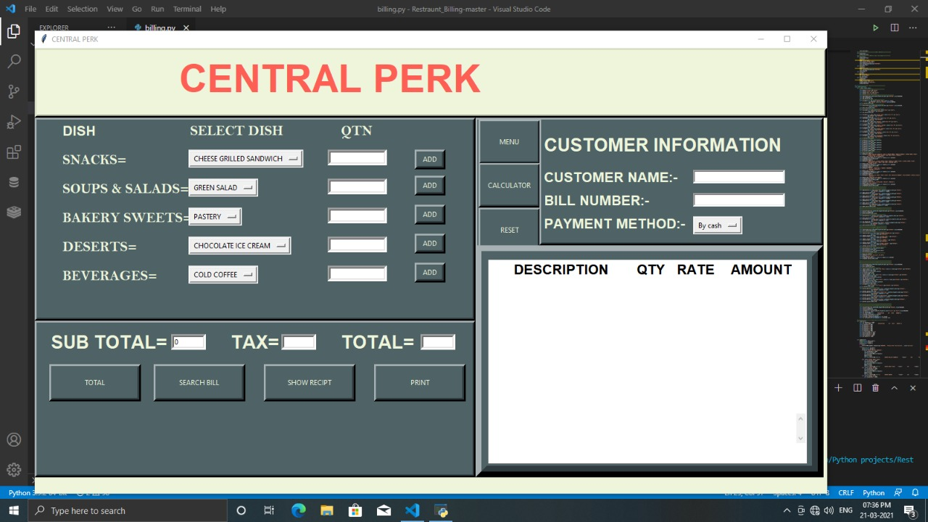
In the figure this page is used for ordering the dishes. One can enter n number of quantities.
Also it has buttons of Menu for viewing Menu , Calculator for Calculation of Bill , show receipt for viewing bill and print to print the bill.
It also displays the customer information like customer name , bill number and asks customer for mode of payment.

Slide 16
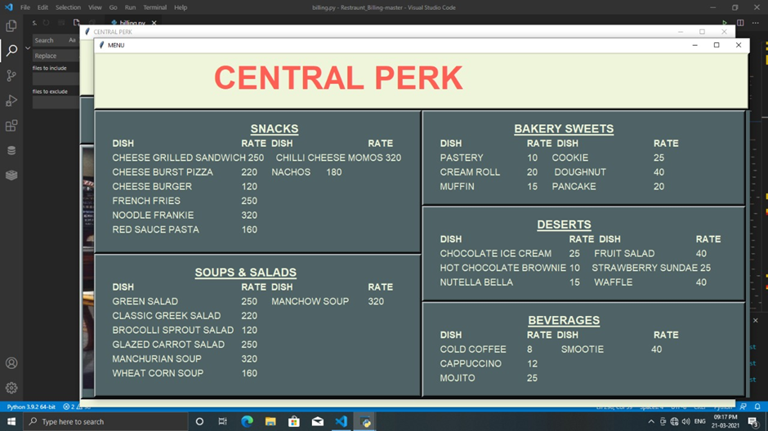
This figure displays menu card for ordering purpose. All the dishes are segregated in different food categories according to their types.

Slide 17
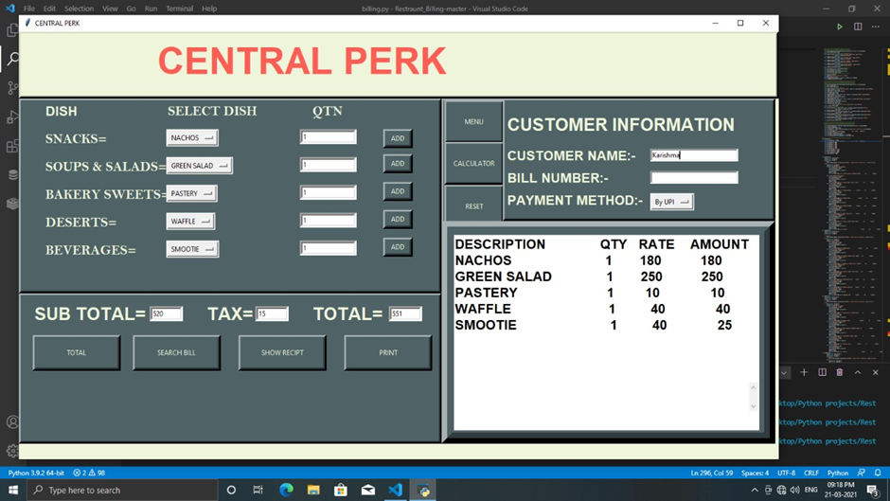
This is how the screen will appear after adding quantities and calculating the total along with description of the order.

Slide 18
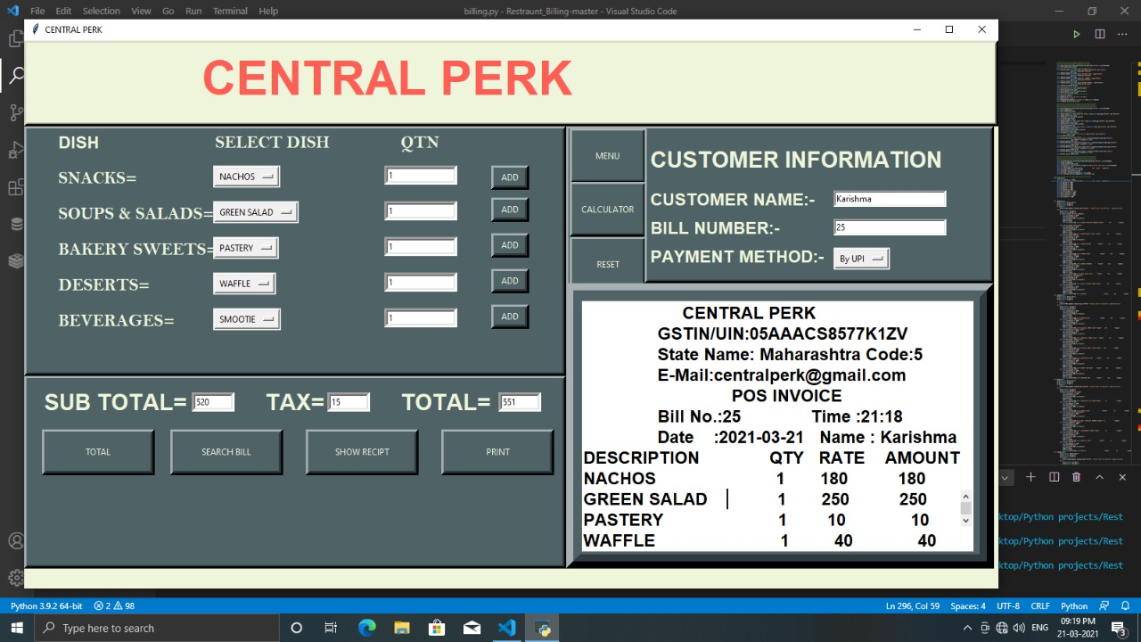
This figure displays the bill along with the taxes and the Customer Information.

Slide 19
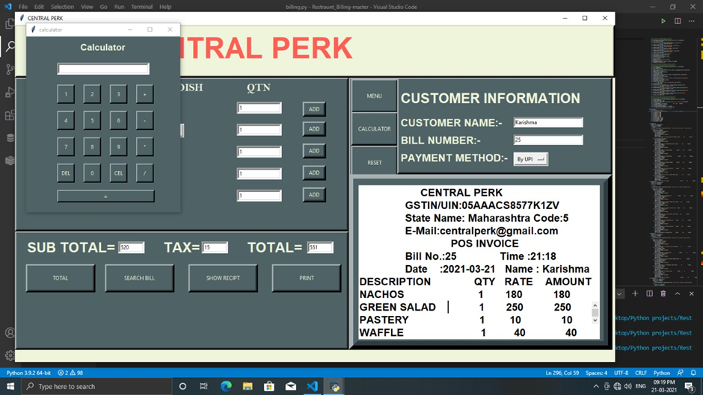
In this figure one can see that the calculator button proves beneficial for the cashier to calculate error free payments.

Slide 20
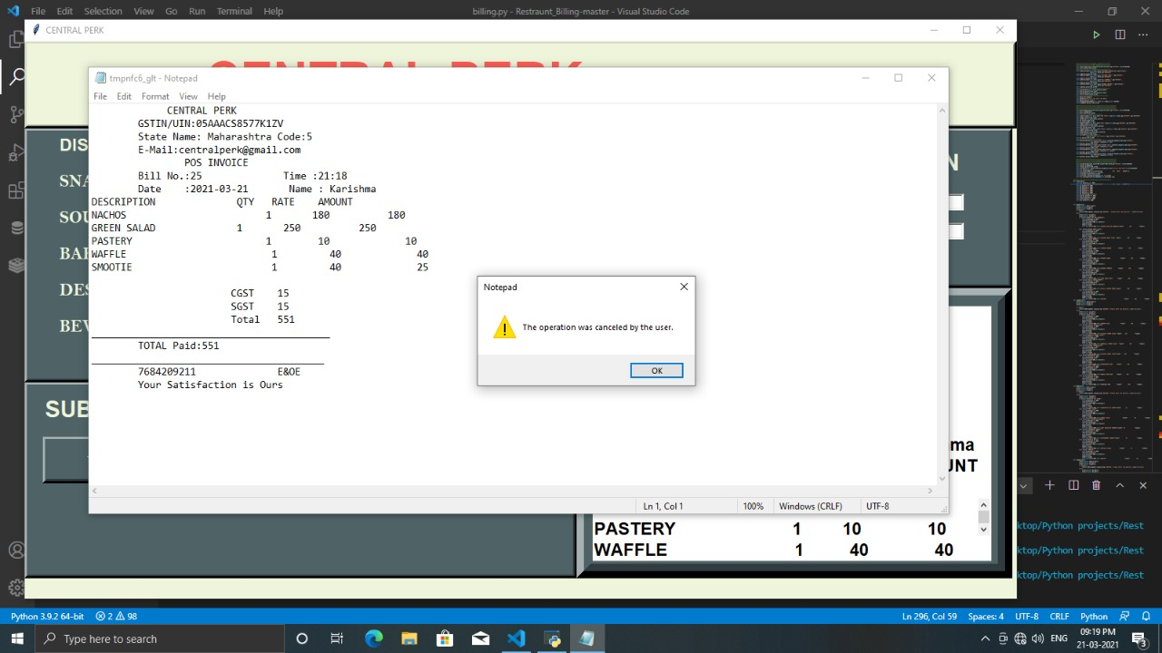
This figure shows the printing of bill.

Slide 21
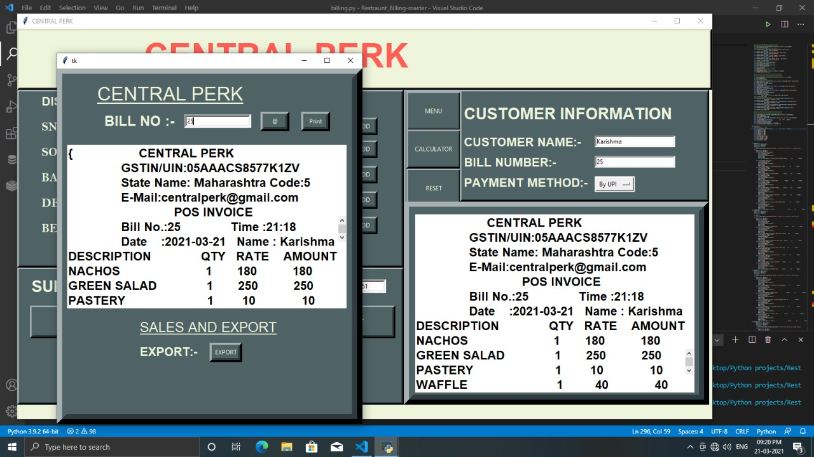
This figure shows Search Bill button which is used to search previous customers bill with all the saved information.

Slide 22
Conclusion
After we have completed the project we are sure the problems in the existing system world overcome.
The "Cafe Billing System" process made computerized to reduce human errors & to increase the efficiency. The main focus of this project is to less human efforts.
The maintenance of the records is made efficient, as all the records are stored in the Access Database, through which data can be retrieved easily.
The navigation control is provided in all the forms to navigate through the large amount of records. If the numbers of records are very large than user has to just type in the search string & user gets the results immediately. The editing is also made simple.
The user has to just type in the required field & process the update button to update the desired field.
The customers are given a particular unique id no. so that they can be access correctly & without errors. Our main aim of the project is to get the correct information about a customer visit in the Cafe.

Slide 23
references
http://eprints.utar.edu.my/3448/1/fyp_IA_2019_WSJ_1506513.pdf
http://www.iaetsdjaras.org/gallery/14-jaras-327-december.pdf
https://www.ijser.org/researchpaper/A-Review-Paper-on-Smart-Restaurant-Ordering-System.pdf
https://www.irjet.net/archives/V7/i4/IRJET-V7I41009.pdf
https://www.iosrjournals.org/iosr-jeee/Papers/Vol10-issue3/Version-1/A010310105.pdf

Slide 24
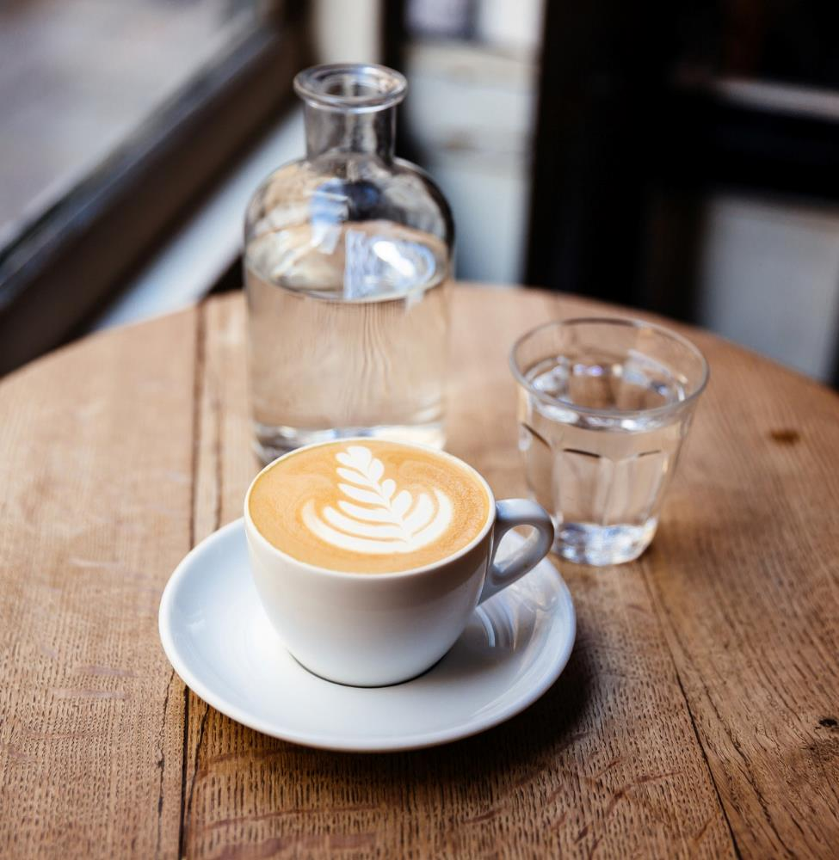
THANK YOU !!

